Slide 1
Review Topics
CISC 2000

Slide 2
Functions Review
Call-By-Value: copies the argument to a new location in stack.
  Original argument will not change
Call-By-Reference: refers to the address of the argument.
  Original argument may change
Overloading Function Names: Same fcnName, diff# or types of param
Default values: assign missing values – starting from the right side

Slide 3
Arrays

Slide 4
Memory allocation
What is the value of
scores ?
int scores[10];
Declaration of array with n elements takes contiguous* chunks of memory to hold each of the n elements
* contiguous: sharing a common border; touching. In computers, typically sequential as well
Variable Byte Address Value
scores[0] | 4902340 | 87
scores[1] | 4902344 | 93
scores[2] | 4902348 | 62
scores[3] | 4902352 | 87
scores[4] | 4902356 | 83
scores[5] | 4902360 | 91
scores[6] | 4902364 | 78
scores[7] | 4902368 | 50
scores[8] | 4902372 | 95
scores[9] | 4902376 | 85

Slide 5
Can we cin >> scores[12] ?
Sure!
But what happens?
Variable Byte Address Value
scores[0] | 4902340 | 87
scores[1] | 4902344 | 93
scores[2] | 4902348 | 62
scores[3] | 4902352 | 87
scores[4] | 4902356 | 83
scores[5] | 4902360 | 91
scores[6] | 4902364 | 78
scores[7] | 4902368 | 50
scores[8] | 4902372 | 95
scores[9] | 4902376 | 85

Slide 6
Array Algorithms/Methods
Print/ Init/Fill: Whole array or part array
Copy: Whole or part from one to another
Compare: Are all elements the same?
Find/Search: min*, max*, value**
Sort. Often uses swap
Insert & Delete (a value from the array)
  sorted and
  unsorted arrays
  * return the index
  ** return the index if found, else -1

Slide 7
The Selection Sort Algorithm
Start with an unordered array of size MAX
End:
a[0] < a[1] < … < a [ MAX-1]
Outline of the algorithm
for (int index = 0; index < MAX; index++)
swap the smallest remaining element with a[index]

Slide 8
Sort – by Hand using Selection Sort
Array |  | 46 | 48 | 29 | 69 | 81 | 19 | 26 | 77 | 14 | 14 | 85 | 2
index |  | 0 | 1 | 2 | 3 | 4 | 5 | 6 | 7 | 8 | 9 | 10 | 11
SortedArray – 1st pass |  | 2 | 48 | 29 | 69 | 81 | 19 | 26 | 77 | 14 | 14 | 85 | 46
SortedArray – 2nd pass
index |  | 0 | 1 | 2 | 3 | 4 | 5 | 6 | 7 | 8 | 9 | 10 | 11
SortedArray – 3rd pass
What variables do we need?

Slide 9
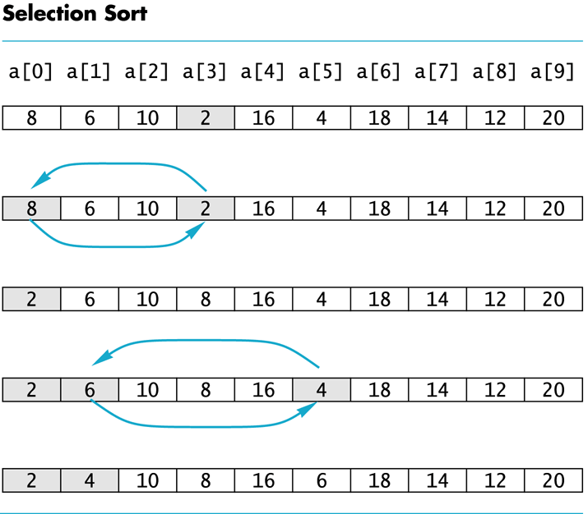
Keep Swapping

Slide 10
Selection sort
Outline of the algorithm
  for (int index = 0; index < number_used; index++)
  place the index-th smallest element in a[index];
Write a function to return the index of the smallest
int index_of_min(int array[], int start , int num_used)
{
int min_index = start;
for (int i = start+1; i < num_used; i++)
if (array[i] < array[min_index])
min_index = i;
return min_index;
}

Slide 11
Strings and cstrings

Slide 12
Compare strings using relational ops ==, !=
To compare strings use ==, !=, <, <=, > and >= as you would with any other types.
To find out if a string is greater, less than or equal in one call, use the compare member function:
string s1 = "hello 1";
string s2 = "hello 2";
int x = s1.compare(s2); // returns x == 0 if they are equal,
  // x < 0 if s1 < s2, and
  // x > 0 if s1 > s2 (length or letter order)
Usage:
  if(s1.compare(s2) == 0)
  // they match

Slide 13
Another useful member function – find()
Find the first occurrence of a char in a string with the find(char c) or find(string s) member function shown below:
string fullname = “Karen Trovato”;
int pos = fullname.find(' '); // or use a string
What happens if the character (or string) is not found in the string?
if (pos == string::npos)
cout << “The character is not there\n”;
else
cout << “The character is at ” << pos << endl;

Slide 14
Copying part of a string – substr()
Sometimes we want to copy parts of a string.
string substr(int startpos, int length);
The substr() member function allows us to make a copy of a substring
string big_str = “Professor Karen Trovato”;
string title = big_str.substr(0,big_str.find(‘ ‘));
Our big_str is unchanged, but we still have the title in a string.

Slide 15
Other variations of substr
If the last parameter is left off, substr() returns the rest of the string.
string full_name = big_str.substr(title.length()+1);
What happens in the find(‘ ‘) returns string::npos?
string title = big_str.substr(0,big_str.find(‘,‘));
If the start position is string::npos, it will fail!

Slide 16
Converting numeric types into a string
We can convert any numeric built-in type in C++ to a string with the to_string() function
string to_string(int);
string to_string(float);
string to_string(double);
NOTE: only supported in C++11 and on (which is default on storm).

Slide 17
stoi , stof, stod Functions:
Converting string to other types
#include <string> // required at the top
string s1 = "42";
int x = stoi(s1); // converts the string to int
string s2 = "42.5";
float x = stof(s1); // string to float
string s2 = "42.5";
double x = stod(s1); // string to double

Slide 18
File Input & Output

Slide 19
File I/O: defining stream names and opening files
#include <fstream>
ifstream infile; // commonly used variable names
ofstream outfile;
infile.open("inventory.dat");
outfile.open("report.txt");
infile.open("test.txt");
if (!infile)
{
cout << "File open failure!"; return;
}

Slide 20
File I/O: Misc Sample Snippets 1
  outfile << "Inventory Report 2023";
  infile >> partNum;
  infile >> qtyInStock >> qtyOnOrder;

Slide 21
File I/O: Misc Sample Snippets 2
  int number;
  while (inFile >> number)…
  string fullstring;
  getline(cin, fullstring); // cin or inFile
  // reads up until the newline

Slide 22
File I/O: User provides file name
string filename; // might read from user
…
infile.open(filename);
if !(infile.is_open()) // another way to check if file open
{
cout << “file “ << filename << “not found\n”;
return;
}
// File is open, now we can read it.
while(infile >> date >> value >> theRest) {
// Process input
}
infile.close();// don’t forget to close!

Slide 23
Pointers
Dynamic Memory allocation with new

Slide 24
Pointers
& Address Of Reference Operator
* Contents Of Dereference Operator
Pointer is an address 64 bits (8 bytes)
Be able to draw diagrams showing where pointers refer
You may wish to consider what happens on the stack

Slide 25
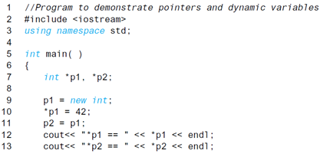

Diagramming: Pointer Variables

Slide 26

Diagramming: Pointer Variables

Slide 27

Diagramming: Pointer Variables

Slide 28

Diagramming: Pointer Variables

Slide 29

Diagramming: Pointer Variables
Both point to the same int in memory

Slide 30

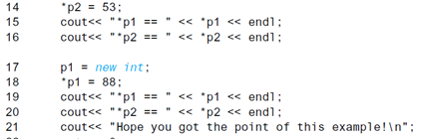
Diagramming
Previously… *p2 was 42

Slide 31

Diagramming
Previously… *p2 was 42

Slide 32

Diagramming
Previously… *p2 was 42

Slide 33

Diagramming

Slide 34

Diagramming

Slide 35
Copy & Paste to see what happens
#include <iostream>
#include <fstream>
#include <string>
#include <vector>
using namespace std;
int main()
{
int x = 5;
cout << "&x=" << &x << endl;
int* pA;
cout << "&pA after int *pA= " << &pA << /*" pA = " << pA <<*/ endl;
pA = &x;
cout << "&pA = &x = " << &pA << " pA = " << pA << endl;
pA = new int;
cout << "&pA = new int = " << &pA << " pA = " << pA << endl;
*pA = 25;
int* pB = pA;
cout << "&pB = " << &pB << "pB=" << pB << endl;
int* pC = new int;
cout << "&pC = " << &pC << "pC=" << pC << endl;
*pB = 50;
*pC = *pA;
cout << "x was " << x << endl;
return 0;
}

Slide 36
sizeof(type)
Type #Bytes 1 Byte = 8 bits
int 4
char 1
float 4
short 2
int * 8 every pointer is 8 bytes… so
Student * 8

Slide 37
Stack
Our simplified view of the stack:
Address Name Type Value
Local variables (such as in main) are added
When function is called, there is space allocated for:
  Return value
  Parameters
  Local variables of the function
Upon leaving, values are ‘erased’ (the top of stack moves back up)

Slide 38
Dynamic Arrays

Slide 39
Dynamic Array & passing it to a Function
In main:
int array_size = 15; // doesn’t have to be a const.
// Can read from user!
int *a = new int[array_size]; // new always returns
// a pointer to the type
a[5]= 21; // access like a regular array
fill_array(a,array_size); // pass the name - like any other array
sort(a, array_size); // pass the size – like any other array
delete [] a; // when finished. System knows the size.
Notes:
So, now that we have dynamic arrays, how would we use them in functions? Take a look at these two function declarations. One is a function to fill the array while the other is a sort function. Both of these take in an array and the size of said array. Now, we know that these work with standard arrays, but how about with dynamic arrays?
Well, the answer is simple - yes, they do work. Don’t have to do anything fancy - just plug the dynamic array as an argument and it will work just fine. Note the lack of asterisk, as you don’t need it.

Slide 40
Dynamic Array & passing it to a Function
In main:
int array_size = 15; // doesn’t have to be a const!
int *a = new int[array_size];
a[5]= 45; // access like a regular array
fill_array(a,array_size);
sort(a, array_size);
delete [] a; // when finished
Notes:
So, now that we have dynamic arrays, how would we use them in functions? Take a look at these two function declarations. One is a function to fill the array while the other is a sort function. Both of these take in an array and the size of said array. Now, we know that these work with standard arrays, but how about with dynamic arrays?
Well, the answer is simple - yes, they do work. Don’t have to do anything fancy - just plug the dynamic array as an argument and it will work just fine. Note the lack of asterisk, as you don’t need it.

Slide 41
Vectors

Slide 42
Vector – quick, flexible 1D array
#include <vector>
In main():
vector<double> values(10); // start it at size 10
// if there is already space, can read or print just like an array
for (int i = 0; i < values.size(); i++)
{
cin >> values[i];
}
.size() gives the #elements in the array. 10 in this case.

Slide 43
Vector – quick, flexible 1D array
vector<double> values; // a list of unknown size that will hold doubles
Flexible size: Can add or remove from the end (back) of the array with push_back & pop_back
values.push_back(x); // assume x has a value 3.11
// values.size() is now 11. The vector is now larger than before!
// values[10] contains 3.11
values.pop_back(); // pick off the one at the end (3.11) & throw it out
// values.size() is now 10

Slide 44
Structures
struct
Your own data type – containing multiple fields

Slide 45
Nested Structures
A structure can contain another structure as a member:
struct PersonInfo
{ string name,
  address,
  city;
  };
  struct Student
  { int studentID;
  PersonInfo pData;
  short yearInSchool;
  double gpa;
  };

Slide 46
Declare & access parts of the struct with . And ->
Student s; //Access fields with . operator
s.StudentID = 1234; // in the Student struct
s.pData.name = "Austin Butler"; // in the nested structure, so two .
Using a Pointer to the Struct: also, commonly with new
Student *sPtr = s; // another ptr to struct made this way: Student *sPtr2 = new Student;
Access fields with arrow : arrow: ‘star dot’ equiv to (*s).pData.name
  sPtr->pData.name
  sPtr->StudentID

Slide 47
Ways to pass structs to a function
By value (copies the whole struct to the parameter)
  NOT EFFICIENT
By reference
  The standard & in the function definition
  Efficient, but values can be changed
3) const ref
func(const Student & stu)
Efficient, but values can NOT be changed
4) Passing a pointer to the struct
Access members with ->
Efficient, but values can be changed

Slide 48
Arrays of structs
Just like any other type:
const int SIZE = 10;
Student arr[SIZE];
Dynamic array of structs:
  Recalling how an int array is declared dynamically:
  int arraySize = 10; // or read from the user
  int *a = new int[arraySize];
int arraySize = 10;
Student *dynStudentArray = new Student[arraySize];

